Slide 1
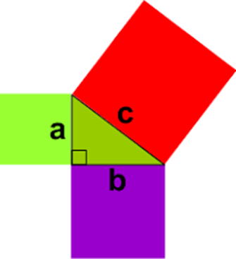
My Pythagoras Interactive Notebook
Name:
Class: 9-9
Term 2 Semester 1

Slide 2
Warm Up
Evaluate 7²
What is the square root of 36?
What angle is the hypotenuse opposite?
3² + 4² = ?²

Slide 3
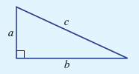
Remember me?
To summarise:
a² + b² = c²
shorter sides longer side (hypotenuse)

Slide 4
Pythagoras’ Theorem
c
hypotenuse
hypotenuse
m
p
hypotenuse
c
a
b
b
a
d
Which of these sides is the hypotenuse?

Slide 5




Now to use this formula
Find the length of the hypotenuse for these:
a) b)

Slide 6
24
7
30
Topic: Pythagoras Theorem
Date
EQ – How do we use Pythagoras to find the length of the shorter sides
We can also use Pythagoras’ theorem to find the length of a shorter
a² = c² – b²
Square the longer side
Subtract the square of the other known side
Square root your answer to get the unknown shorter side
How do you find the length of the Shorter Side?

Slide 7
Example
a² = c² - b²
a² = 13² - 12²
a² = 169 - 144
a² = 25
a = √25
a = 5 cm
13cm
12cm
a

Slide 8
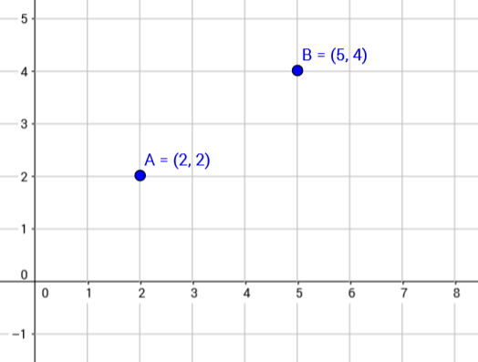
24
7
30
Date
Using Pythagoras on a graph
EQ – How can I apply Pythagoras’ theorem to find the length of a line on a graph?
To find the length of AB I can break this down into the horizontal and vertical components

Slide 9
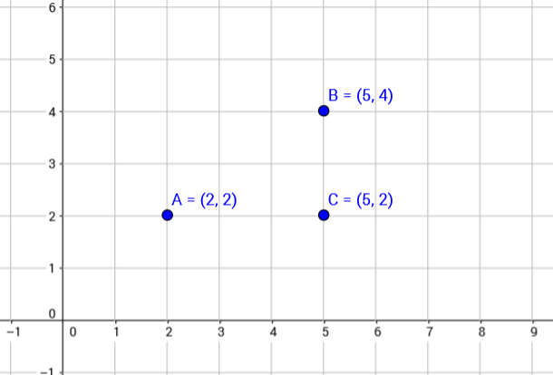
24
7
30
Date
Using Pythagoras on a graph
EQ – How can I apply Pythagoras’ theorem to find the length of a line on a graph?
Put in a new point C and draw a right angle triangle

Slide 10
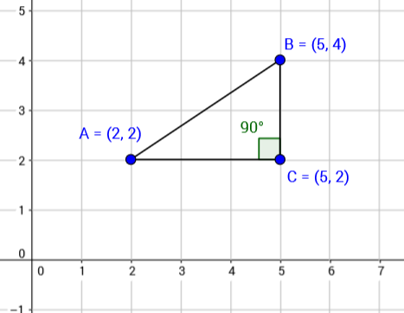
24
7
30
Date
Using Pythagoras on a graph
EQ – How can I apply Pythagoras’ theorem to find the length of a line on a graph?
Now to find the length from A to B (line AB) I can use Pythagoras

Slide 11
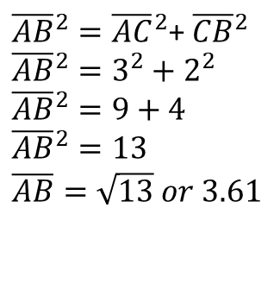
24
7
30
Date
Using Pythagoras on a graph
EQ – How can I apply Pythagoras’ theorem to find the length of a line on a graph?
Now to find the length from A to B (line AB) I can use Pythagoras
${\overline{AB}}^{2}={\overline{AC}}^{2}$+ ${\overline{CB}}^{2}$
$${\overline{AB}}^{2}=3^{2}+2^{2}$$
$${\overline{AB}}^{2}=9+4$$
$${\overline{AB}}^{2}=13$$
$$\overline{AB}=\sqrt{13} or 3.61$$

Slide 12
Notes Review
24, 7 ,30
Date
Title
Essential question
Notes complete
Notes complete with colour and diagrams
Questions completed
Contents page filed in
Formula page filled in

Slide 13
Plenary
A plane flies due north for 180km, then due west for 260km. How far is the plane from it’s starting position?
Draw and label a triangle to represent the situation
Write out the formula you’d use to answer the question
Find the distance

Slide 14
Homework
Review your notes and write a summary answering the essential question.
Ex 7.5

